Slide 1

CrashAlert
Enhancing Peripheral Alertness for Eyes-Busy Interaction while Walking
Human-Computer Interaction Lab
Juan David Hincapié-Ramos
jdhr@cs.umanitoba.ca
Pourang Irani
irani@cs.umanitoba.ca
In Proceedings of the SIGCHI Conference on Human Factors in Computing Systems (CHI '13)

Slide 2
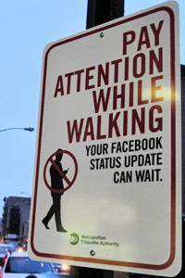
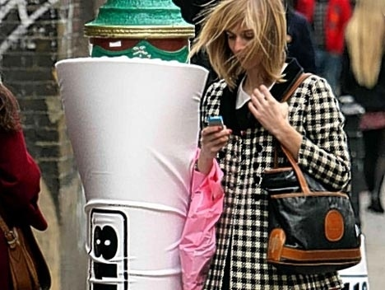
Eyes-busy interaction, such as text-entry while walking can be dangerous and life-threatening.
Jay Shells’ Metropolitan Etiquette Authority
Padded Lampposts at London’s Brick Lane by 118 118 (www.118.com)

Slide 3
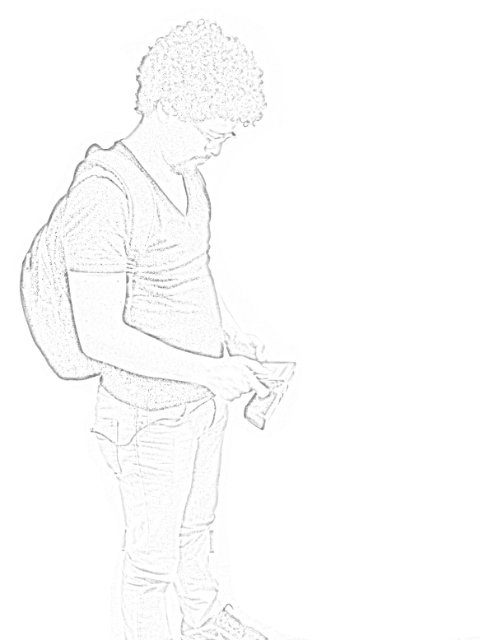
When people walk and multi-task much of their field-of-view attends to the display.
This has motivated eyes-free interaction but also warrants investigation into methods for assisting with eyes-busy interaction while walking.
User FoV

Slide 4
Collision Management
Dodge & Slow Down
Heads Up
Full Stop
Nearly Crash
Least Severe
Handling Severity Safety ‘Cost’
Most Severe
Requirements for Safety Walking User Interfaces (WUI)
Encourage More Dodging
Alert on Imminent Collisions

Slide 5
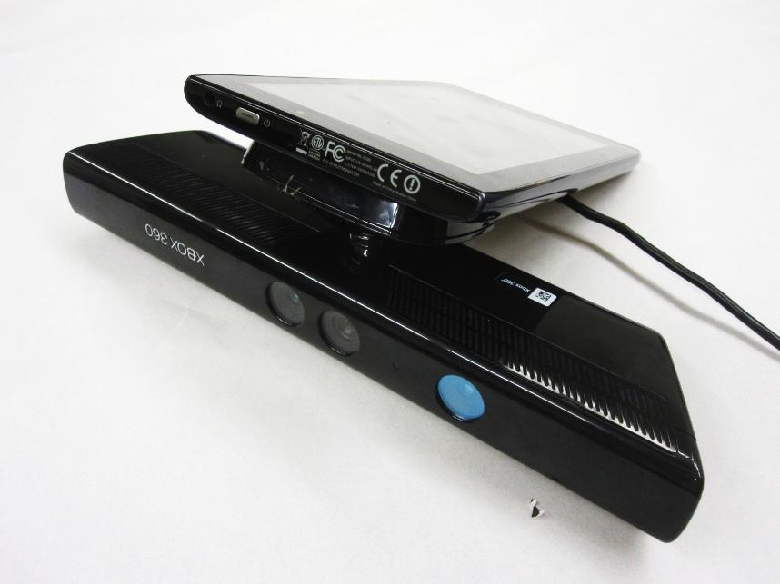
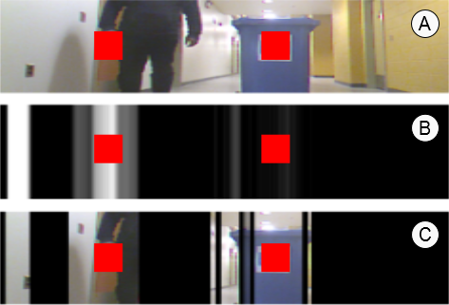
CrashAlert
We introduce
CrashAlert brings peripheral content from the environment into the user’s field-of-view, on the mobile device

Slide 6

We process information from a depth camera attached to the mobile device to show relevant bits of information.

Slide 7
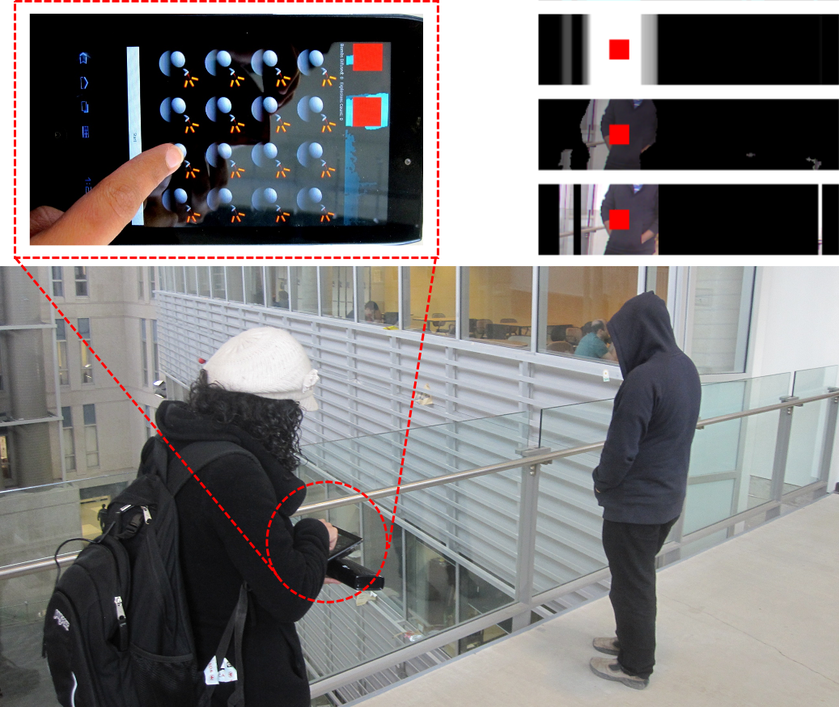

Slide 9
We process information from a depth camera attached to the mobile device [show image] to show relevant bits of information
[show a person walking, and screen capture of the laptop]

Slide 10
Our results show that users feel safer with CrashAlert, do not require lifting their heads as much from the task and ....
Their performance on the task is also not affected by using the ambient display
[shows some graphs]

Slide 13
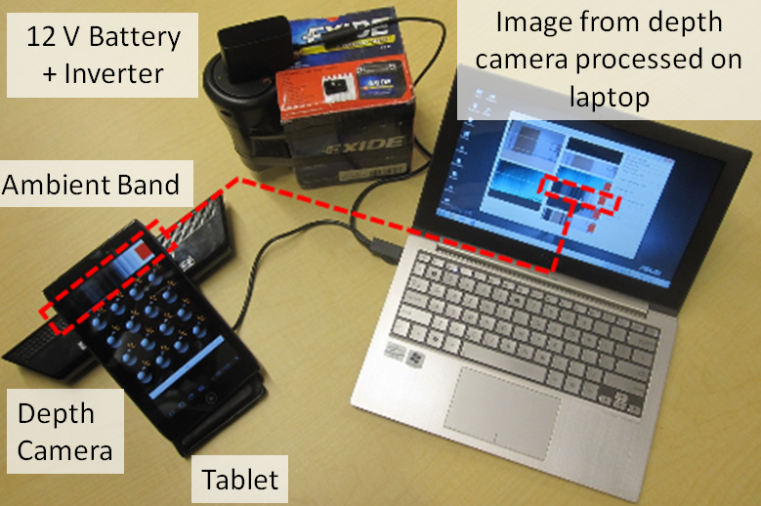
Transformed Depth Slice Image on Ambient Band
Camera FoV
Depth Slice
User FoV

Slide 18
Evaluation and User Feedback
Goal: Observe safety behaviours when people walk and use their mobiles with CrashAlert
Participants: 8 university students
Design: 4 conditions (none, color, depth, mask) 2 Trials/Condition
Task: Walk while play Whack-a-mole

Slide 19
Black
Color
Depth
Mask

Slide 20
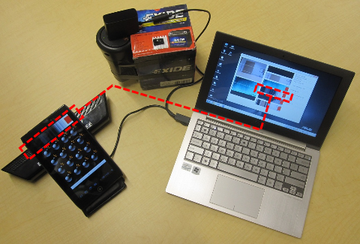
Image from depth camera processed on laptop
12 V Battery + Inverter
Ambient Band
Depth
Camera
Tablet

Slide 21
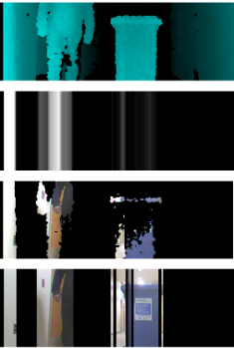
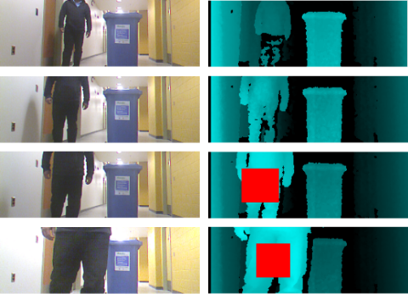
a
b
c
d

Slide 22
Safety
Efficiency
Alertness

Slide 23
Safety
Walk Faster
Black
Color
Depth
Mask
Notes:
Black

Slide 24
Our results show that with CrashAlert users:
Walk in a safer way (more dodges/slowdowns)
Task performance is not affected by the visuals
Perceived safer walking

